Slide 1

Introduction to
Data Visualisation
Data Visualisation

Slide 2
Overview
What is Data Visualisation?
    How would we visualise this?
Beautiful Visualization's
Learning from the classics
Data Visualisation types
Appropriate format
Conclusions

Slide 3
What is Data Visualisation?
“To communicate information clearly and effectively through graphical means". - Vitaly Friedman (2008)
Google have tracked their top four searched words for a given month. The results show that that the most popular terms searched for are “Candy”, “Chocolate”, “Flower” and “Valentine”. The number of times each term was searched for was 8,000,000 (Candy), 9,500,000 (Chocolate), 17,000,000 (Flower) and 4,900,000 (Valentine) respectively.

Slide 4
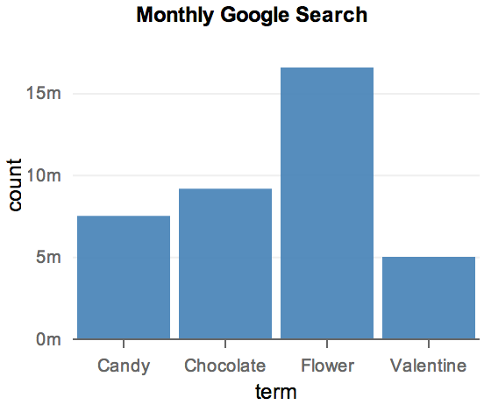
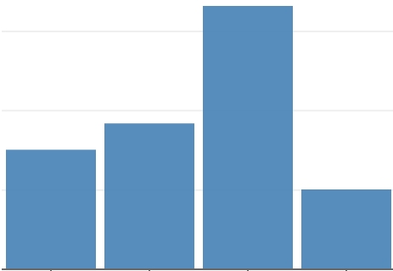
What is Data Visualisation?
1. Communicate information
Candy | Chocolate | Flower | Valentine
8,000,000 | 9,500,000 | 17,000,000 | 4,900,000
3. Clearly and effectively
2. Graphical means

Slide 5
How would we visualise this?
During the period of 1990 to 2007 in the US, cigarette production, exports and domestic consumption seen some interesting results. For the most part, all three declined over this timeframe. In 1990, figures for production stood at 710, exports at 170 and domestic at 520 billion respectively. In 2005, production fell to 500, exports to 100 and domestic to 370 billion. For the years in between, production was at 750, exports at 220 and domestic at 490 billion in 1995 and in 2000 production was at 600, exports at 160 and domestic at 430 billion.
1. Communicate information
 | 1990 | 1995 | 2000 | 2005
Production | 710 | 750 | 600 | 500
Exports | 170 | 220 | 160 | 100
Domestic | 520 | 490 | 430 | 370

Slide 6
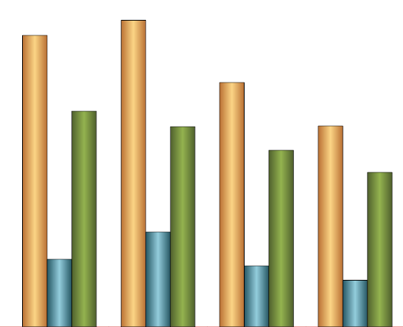
How would we visualise this?
2. Graphical means

Slide 7
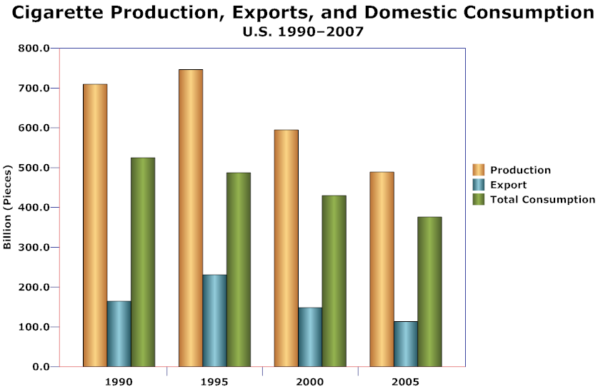
How would we visualise this?
3. Clearly and effectively

Slide 8
How would we visualise this?
John has four friends, Fiona has five friends and Mark has three friends. John’s friends are Paddy, Tom, Ross and Sally. Fiona’s friends are Katherine, Colin, Jamie, Dylan and Mark. Mark’s friends are and Megan, Ross and Fiona.
Note - This is a close set of people so if the name is mentioned more than once you can presume it is the same person, for example Fiona.
1. Communicate information
 | Number of Friends | Friends names | Number of Friends in common
John | 4 | Paddy, Tom, Ross and Sally | 1
Fiona | 5 | Katherine, Colin, Jamie, Dylan and Mark | 1
Mark | 3 | Megan, Ross and Fiona | 2

Slide 9
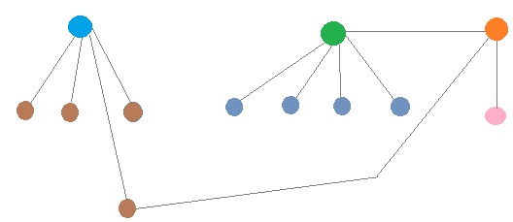
How would we visualise this?
2. Graphical means

Slide 10
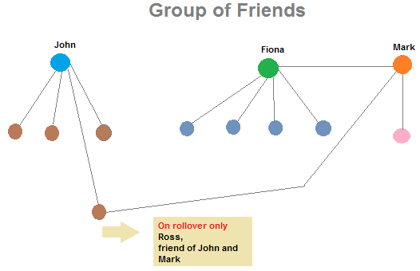
How would we visualise this?
3. Clearly and effectively

Slide 11
What is Data Visualisation?
Typically involves huge volumes of data
Help see things that are not so obvious
Looking to spot patterns or trends
Share the visualisation
Users of all disciplines
Balance between design and function
Comparisons

Slide 12
Beautiful Visualization's
What do we mean when we say a visual is beautiful?
  Novel
  Informative
  Efficient
  Aesthetic
  Emphasize what matters

Slide 13
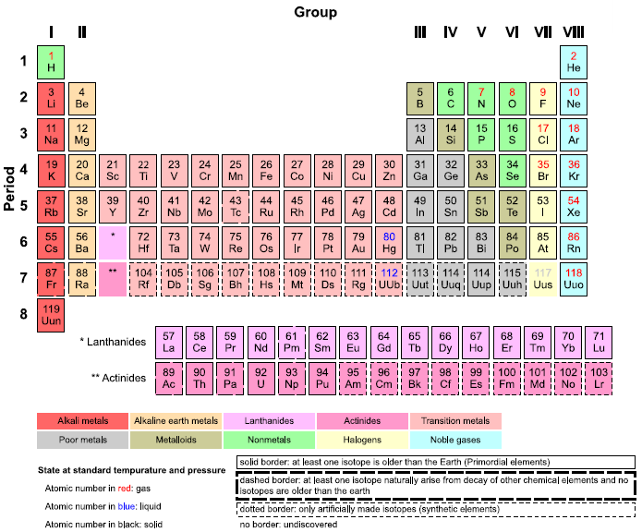
Learning from the classics
Periodic Table

Slide 14
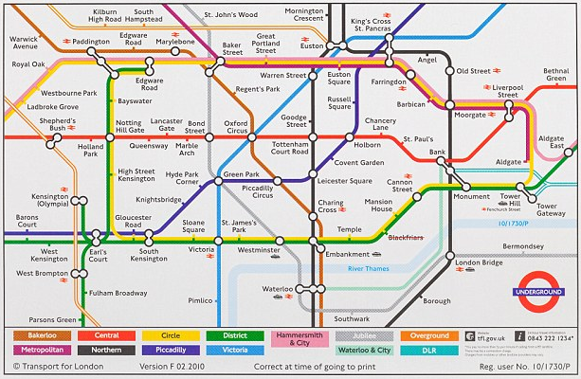
Learning from the classics
Underground Map

Slide 15
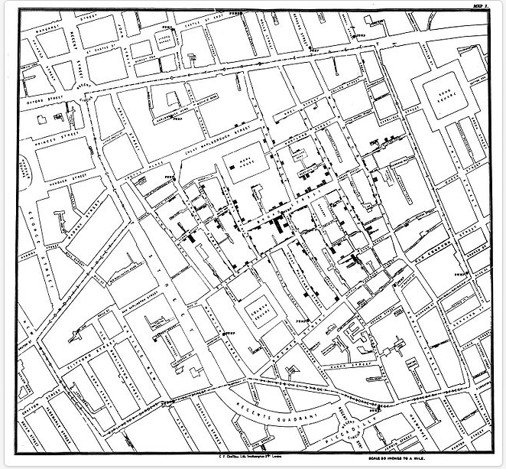
Learning from the classics
Thematic map - John Snow's cholera map 1854

Slide 16
Data Visualisation types
Many different way to visualise our data.
Here are some old and new
  https://developers.google.com/chart/interactive/docs/gallery

Slide 17
Why do we need it?
Think of examples were data visualisation could be used
What problems could it help solve or identify in the;
    Work place
    College
    Ireland

Slide 18
Appropriate format
What visualisation would we use to show the electoral votes across a country?
Map
Does this map need to be accurate in terms of geography?
To a degree
Or does this map need to accurately show how the electoral votes matter?
Yes, otherwise it is misleading

Slide 19
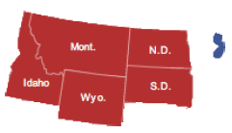
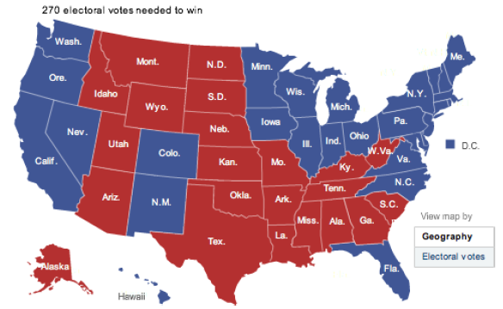
Appropriate format
Choropleth Map of US Electoral Vote

Slide 20
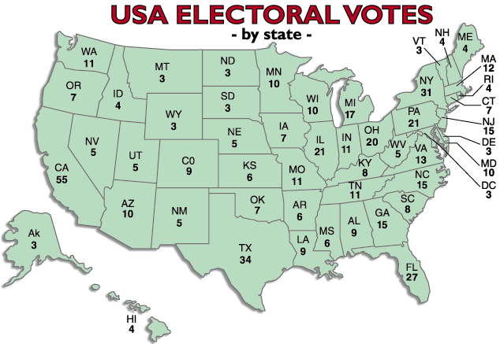
Appropriate format

Slide 21

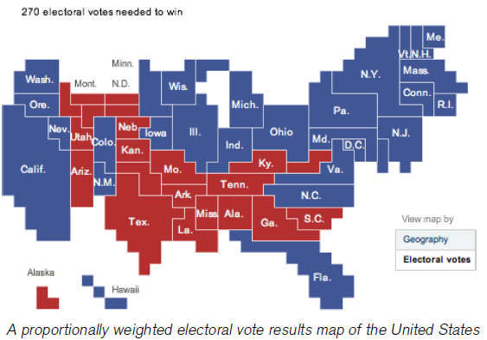
Appropriate format

Slide 22
Conclusions
Keys for successful and beautiful visualisations;
  Useful
  Relevant
  Efficient
  Use defaults
  Aesthetic treatments with injection

